Slide 1
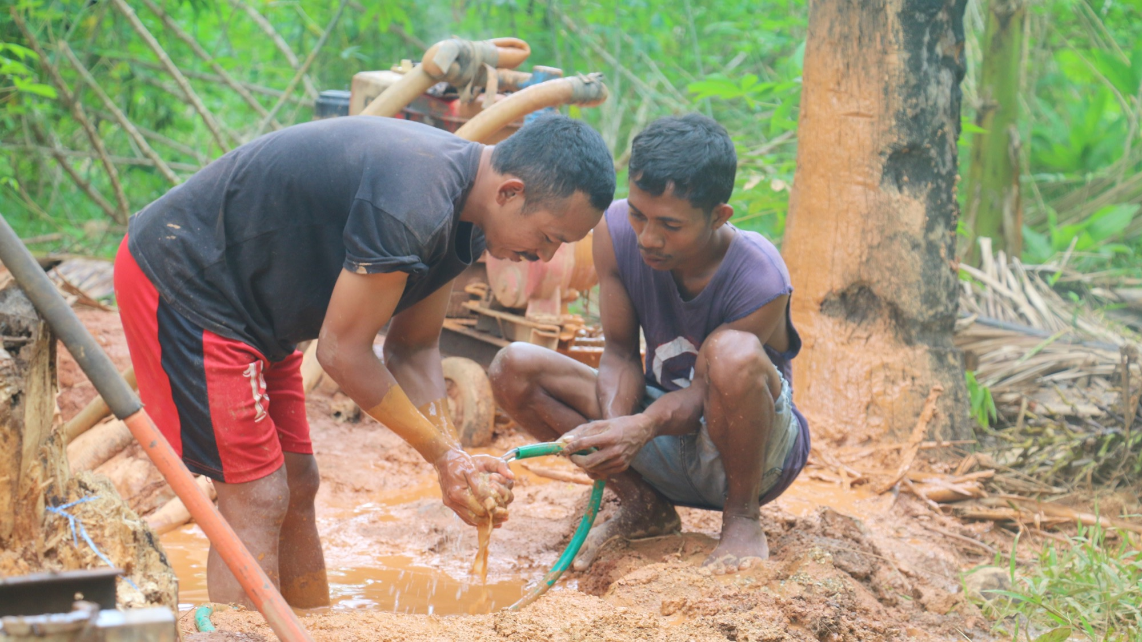

WATER PROJECT
2022
Jesuit Social Service – Timor Leste (JSS)
The Joy of Service

Slide 2


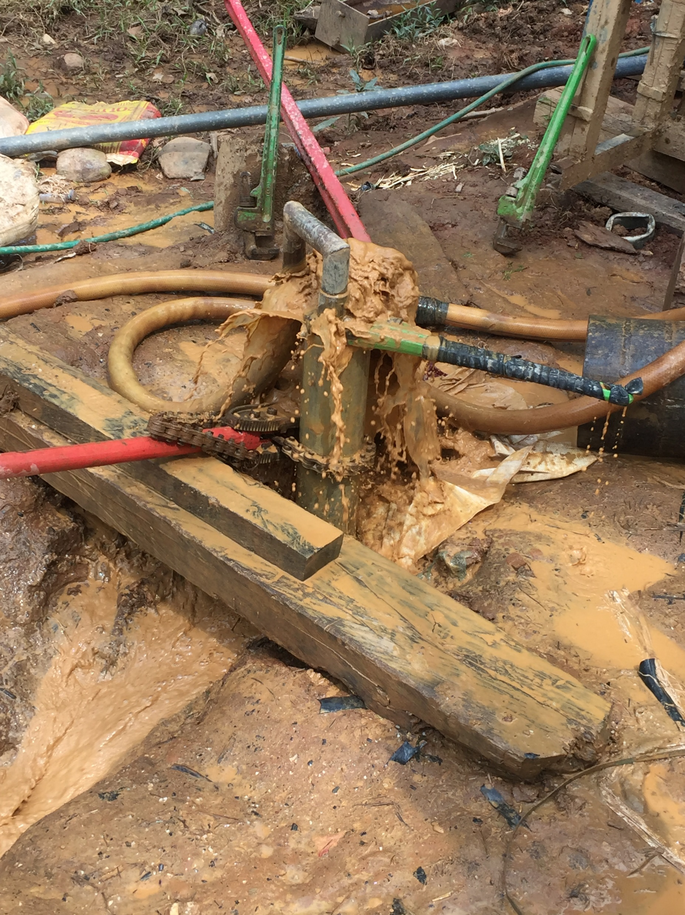
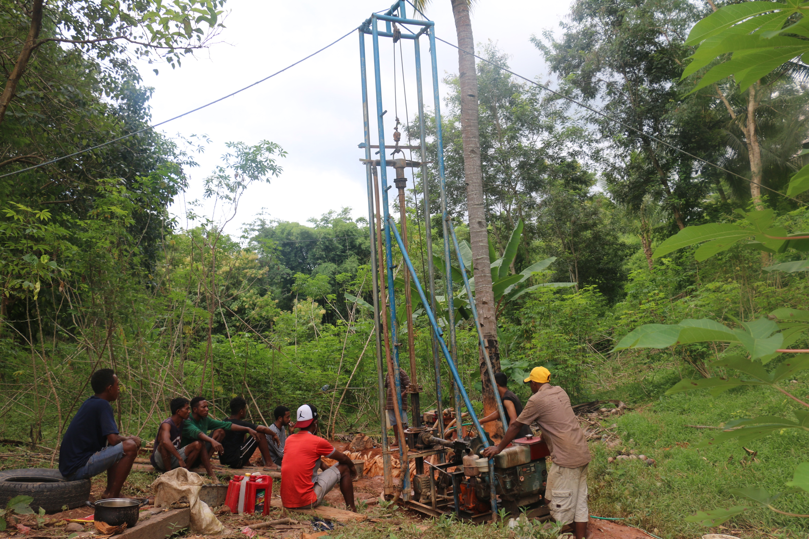
.
Notes:
We enact and fulfil our ministry through the lens of Catholic Social Teaching and Ignatian spirituality, which influences and shapes our relationships, operations and decision-making
We invite companions into authentic and mutually transformative relationships with Jesuit Mission, our international partners and the communities they serve to build awareness of global injustice and inspire actions of solidarity for a more just world.
We strengthen the accompaniment of our international partners to enable poor and marginalised communities to build the skills, capacity and resilience to live full and free lives.
We build a sustainable mission underpinned by a strong financial base, operational excellence, good governance and are supported by passionate people who share our vision, mission and values.

Slide 3
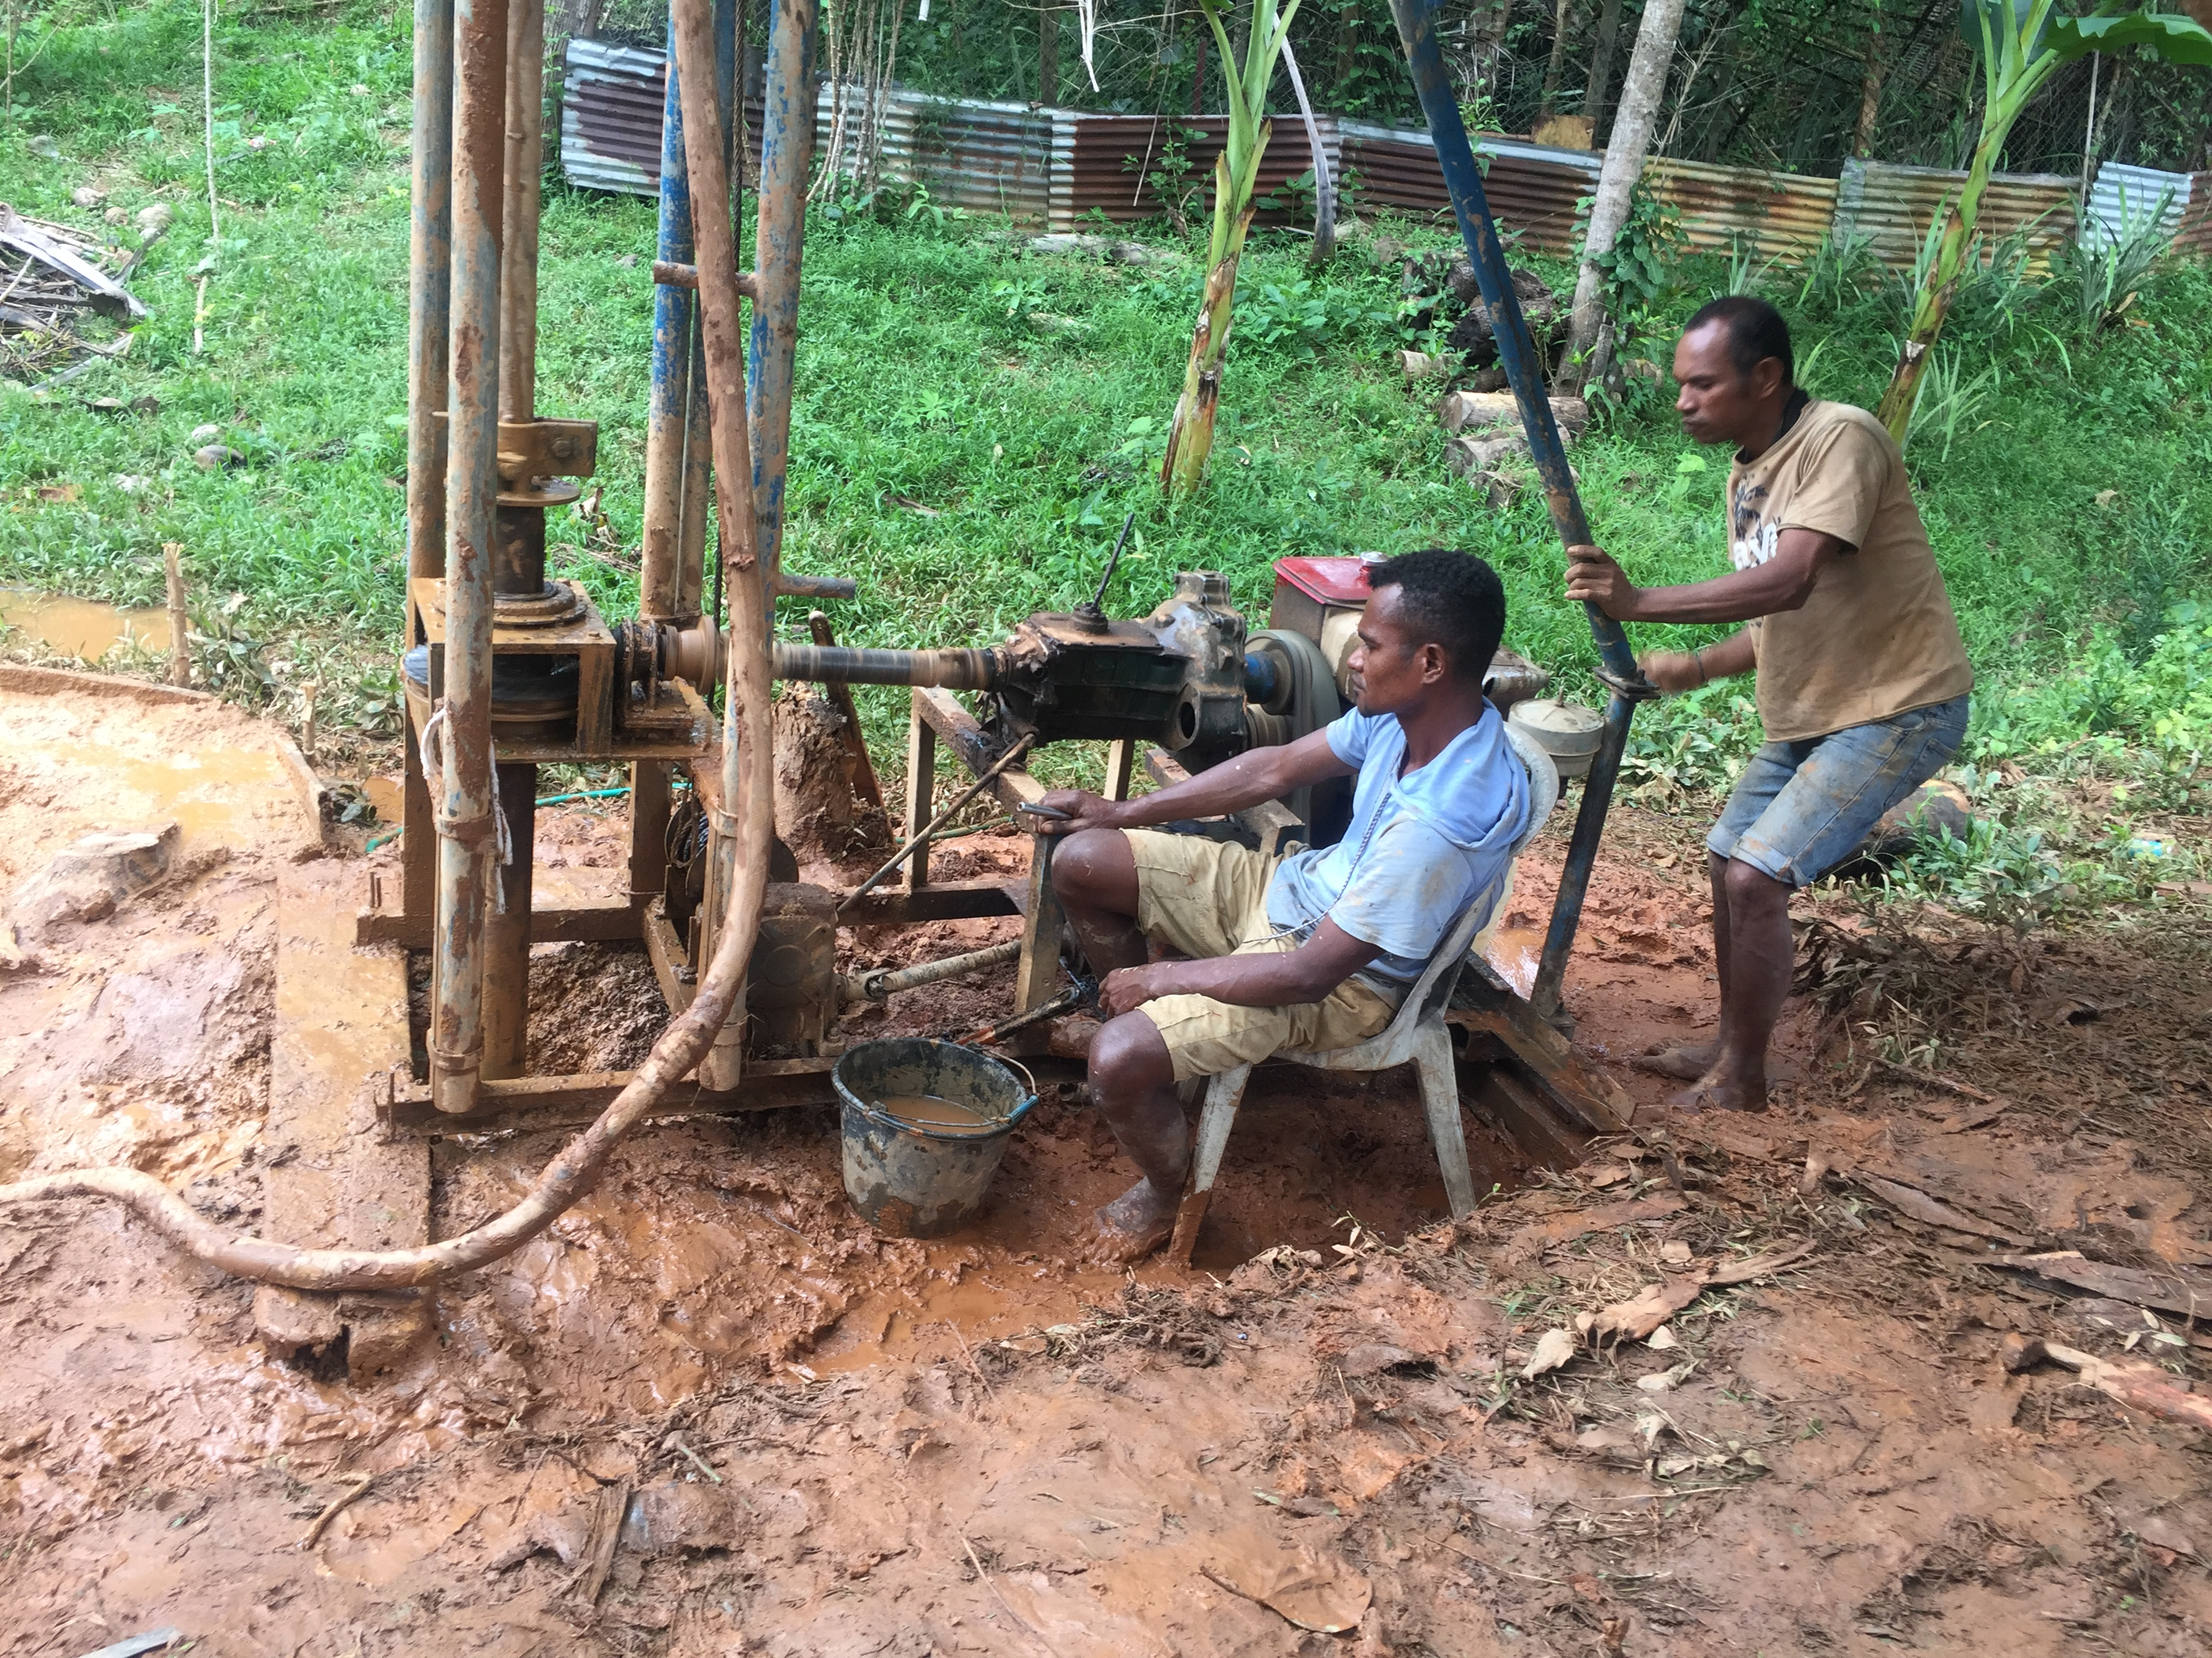
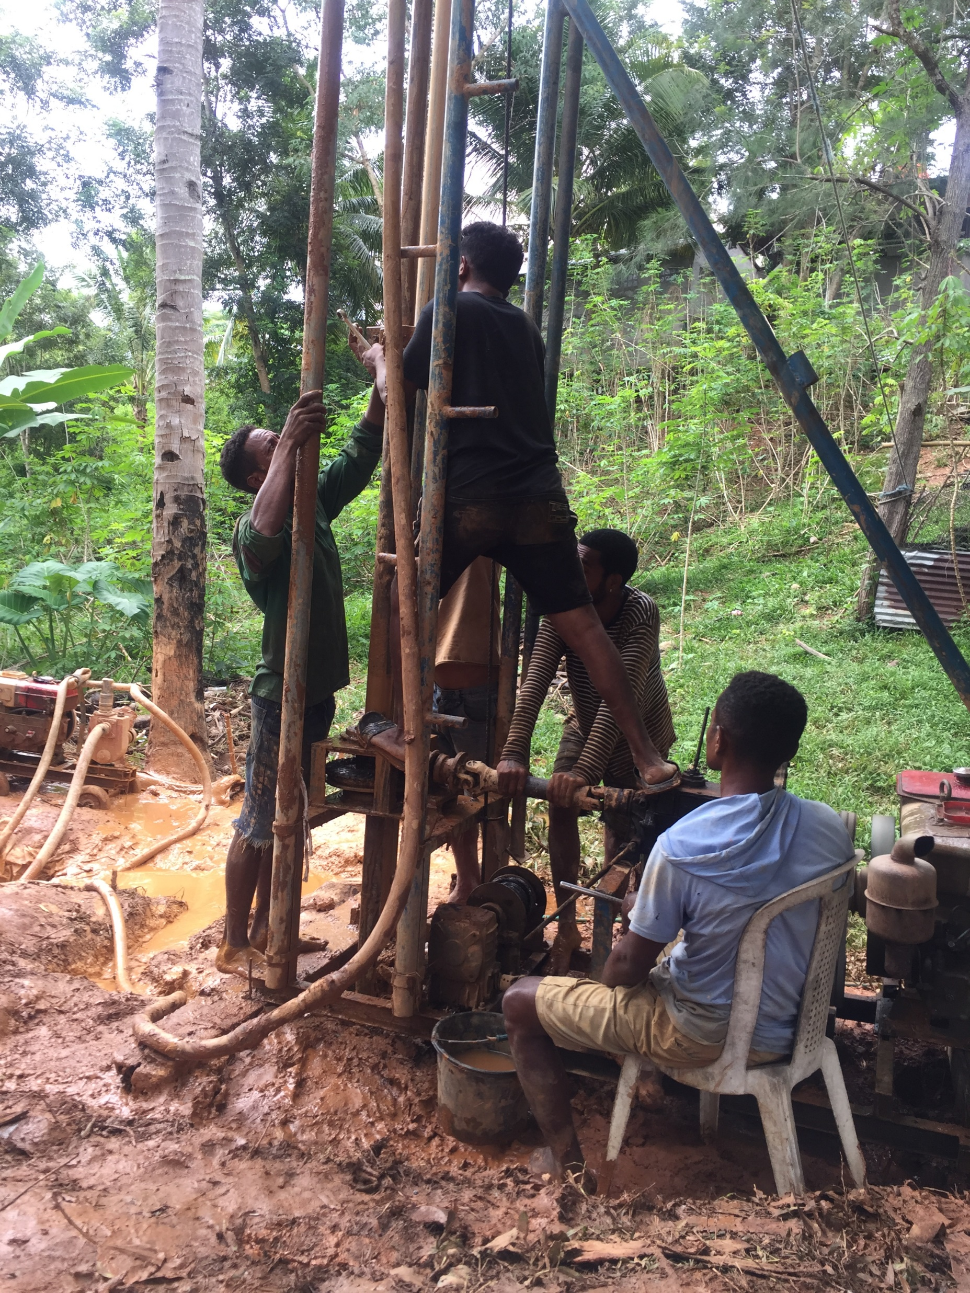
.
Notes:
We enact and fulfil our ministry through the lens of Catholic Social Teaching and Ignatian spirituality, which influences and shapes our relationships, operations and decision-making
We invite companions into authentic and mutually transformative relationships with Jesuit Mission, our international partners and the communities they serve to build awareness of global injustice and inspire actions of solidarity for a more just world.
We strengthen the accompaniment of our international partners to enable poor and marginalised communities to build the skills, capacity and resilience to live full and free lives.
We build a sustainable mission underpinned by a strong financial base, operational excellence, good governance and are supported by passionate people who share our vision, mission and values.

Slide 4
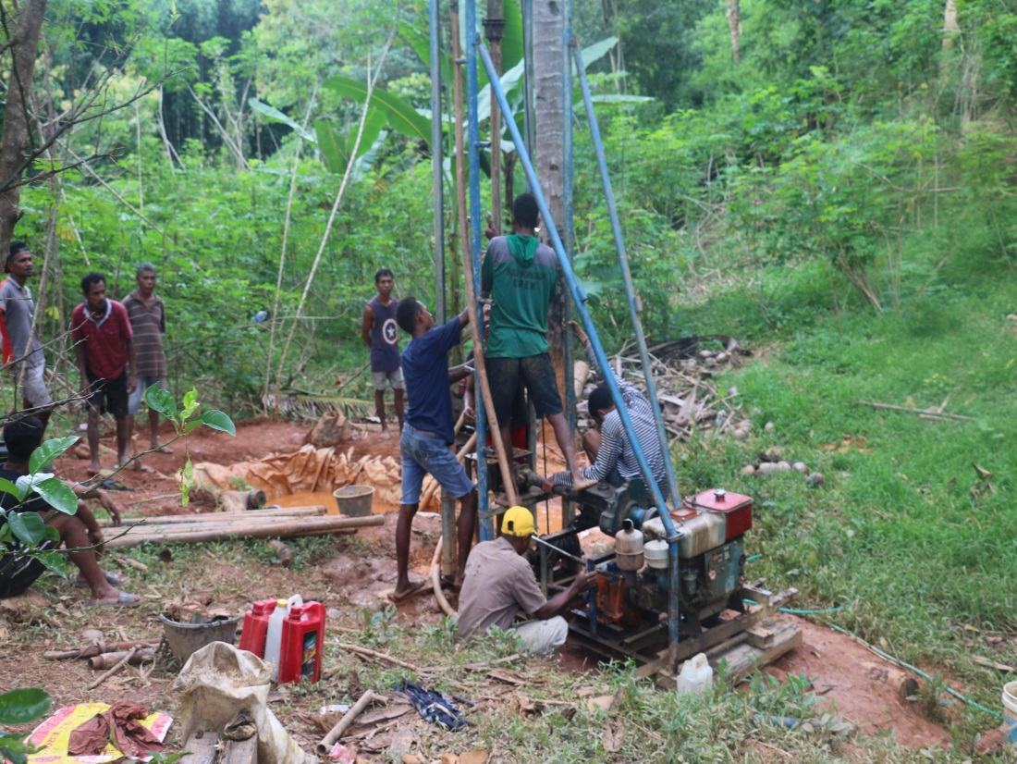
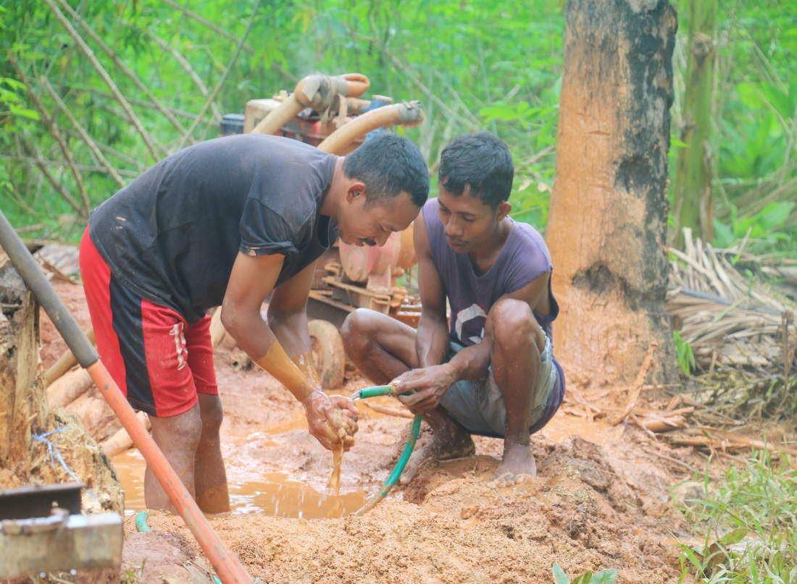
.
Notes:
We enact and fulfil our ministry through the lens of Catholic Social Teaching and Ignatian spirituality, which influences and shapes our relationships, operations and decision-making
We invite companions into authentic and mutually transformative relationships with Jesuit Mission, our international partners and the communities they serve to build awareness of global injustice and inspire actions of solidarity for a more just world.
We strengthen the accompaniment of our international partners to enable poor and marginalised communities to build the skills, capacity and resilience to live full and free lives.
We build a sustainable mission underpinned by a strong financial base, operational excellence, good governance and are supported by passionate people who share our vision, mission and values.

Slide 5
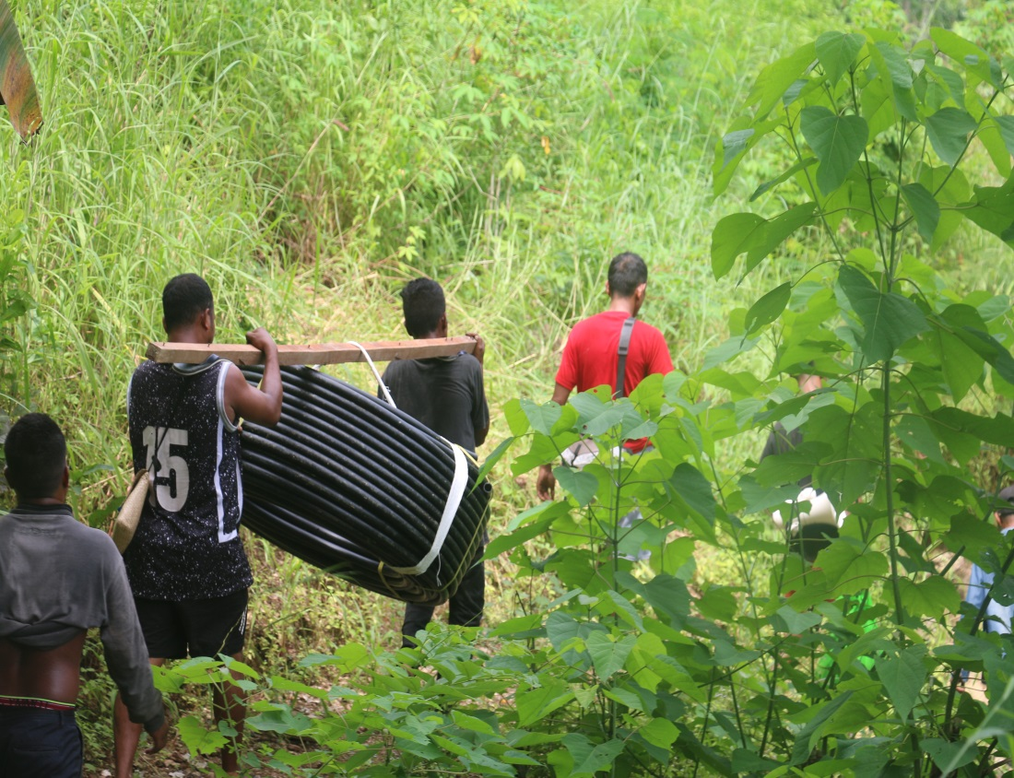
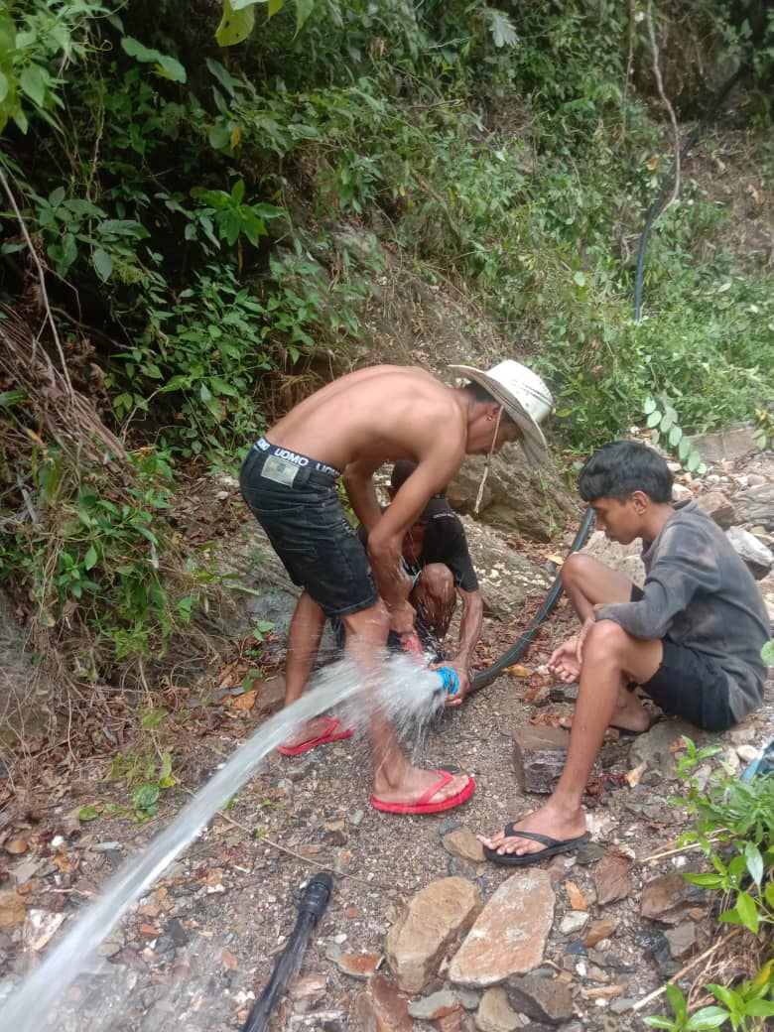
.
Notes:
We enact and fulfil our ministry through the lens of Catholic Social Teaching and Ignatian spirituality, which influences and shapes our relationships, operations and decision-making
We invite companions into authentic and mutually transformative relationships with Jesuit Mission, our international partners and the communities they serve to build awareness of global injustice and inspire actions of solidarity for a more just world.
We strengthen the accompaniment of our international partners to enable poor and marginalised communities to build the skills, capacity and resilience to live full and free lives.
We build a sustainable mission underpinned by a strong financial base, operational excellence, good governance and are supported by passionate people who share our vision, mission and values.

Slide 6
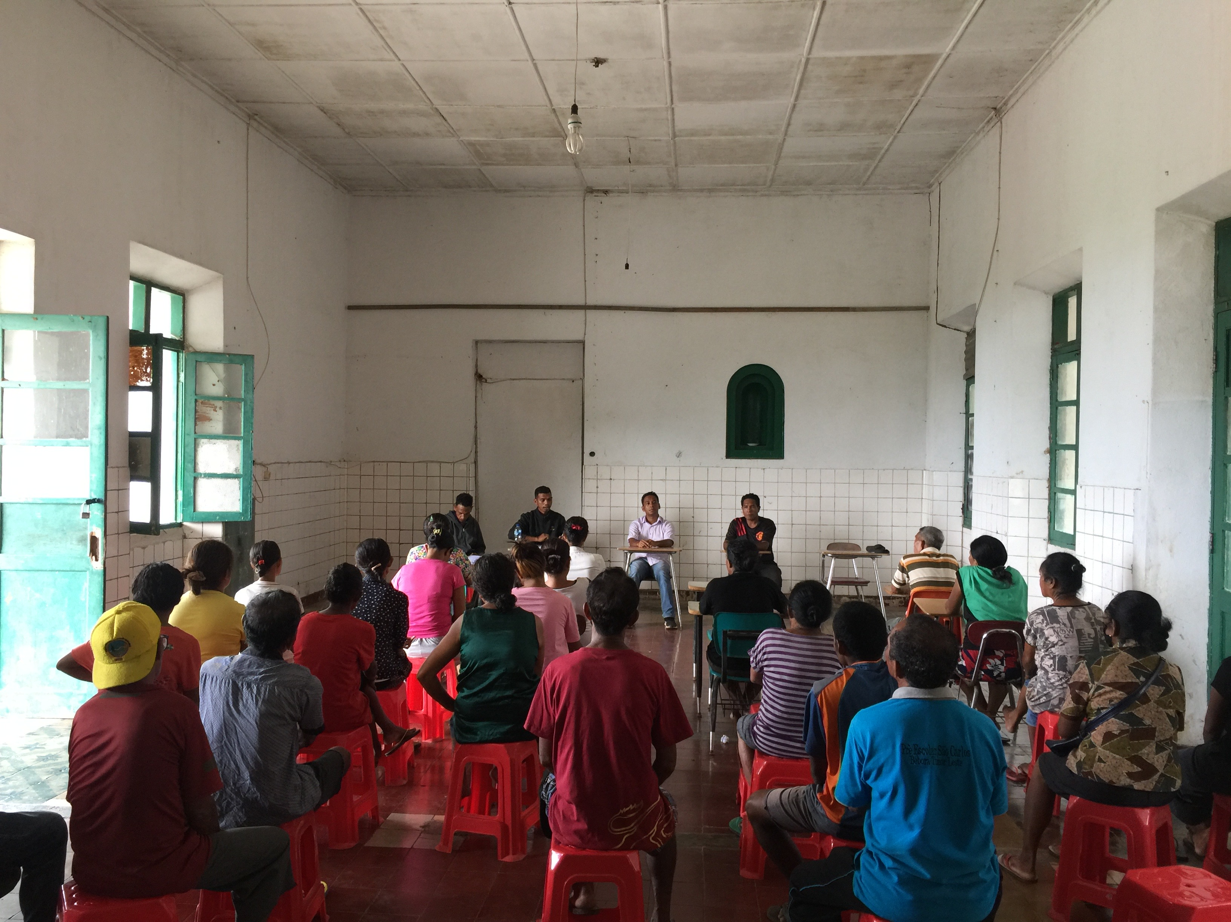
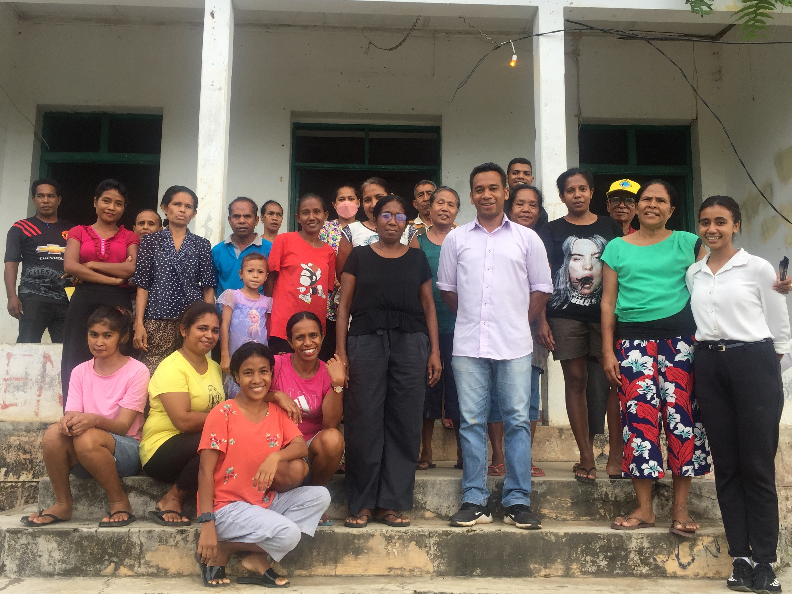
.
Notes:
We enact and fulfil our ministry through the lens of Catholic Social Teaching and Ignatian spirituality, which influences and shapes our relationships, operations and decision-making
We invite companions into authentic and mutually transformative relationships with Jesuit Mission, our international partners and the communities they serve to build awareness of global injustice and inspire actions of solidarity for a more just world.
We strengthen the accompaniment of our international partners to enable poor and marginalised communities to build the skills, capacity and resilience to live full and free lives.
We build a sustainable mission underpinned by a strong financial base, operational excellence, good governance and are supported by passionate people who share our vision, mission and values.

Slide 7
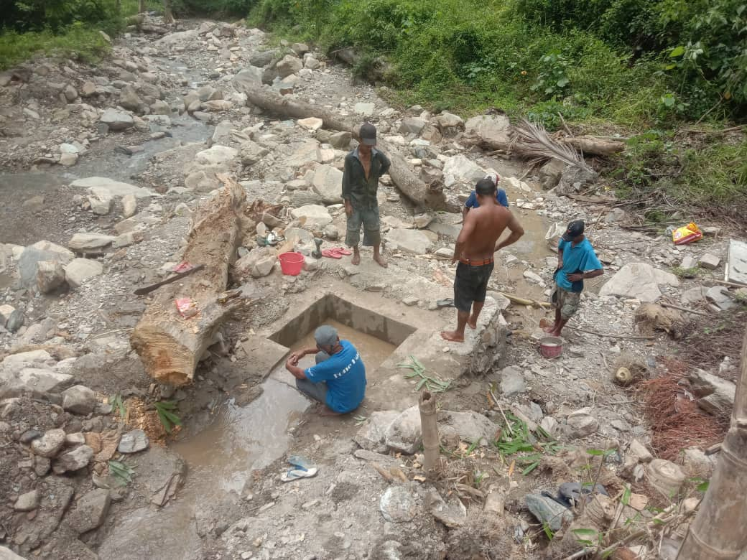
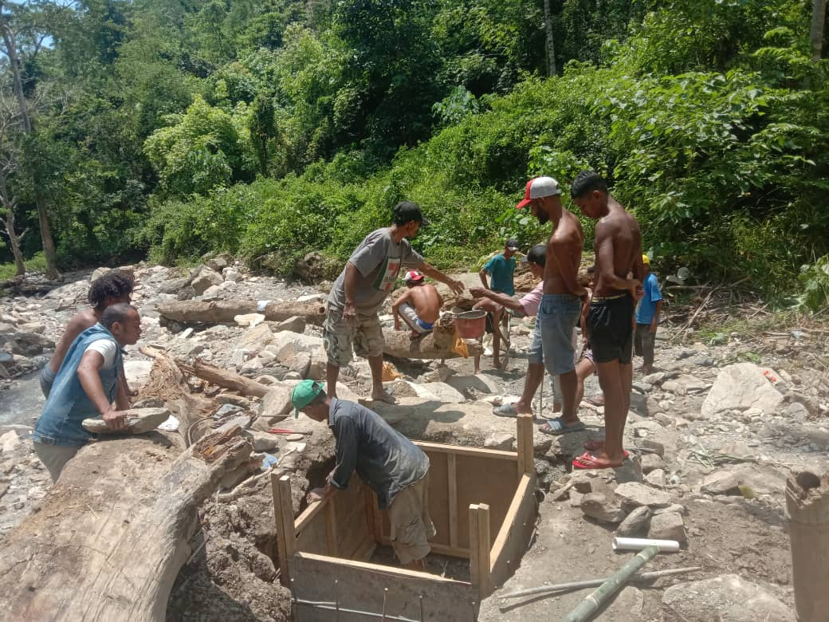
.
Notes:
We enact and fulfil our ministry through the lens of Catholic Social Teaching and Ignatian spirituality, which influences and shapes our relationships, operations and decision-making
We invite companions into authentic and mutually transformative relationships with Jesuit Mission, our international partners and the communities they serve to build awareness of global injustice and inspire actions of solidarity for a more just world.
We strengthen the accompaniment of our international partners to enable poor and marginalised communities to build the skills, capacity and resilience to live full and free lives.
We build a sustainable mission underpinned by a strong financial base, operational excellence, good governance and are supported by passionate people who share our vision, mission and values.

Slide 8
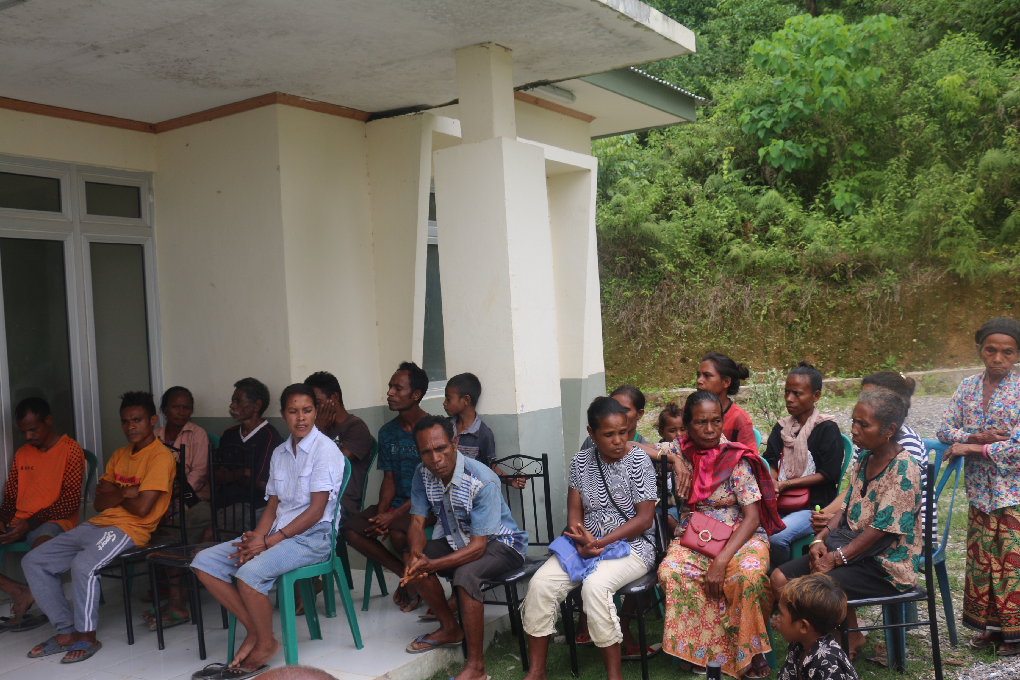
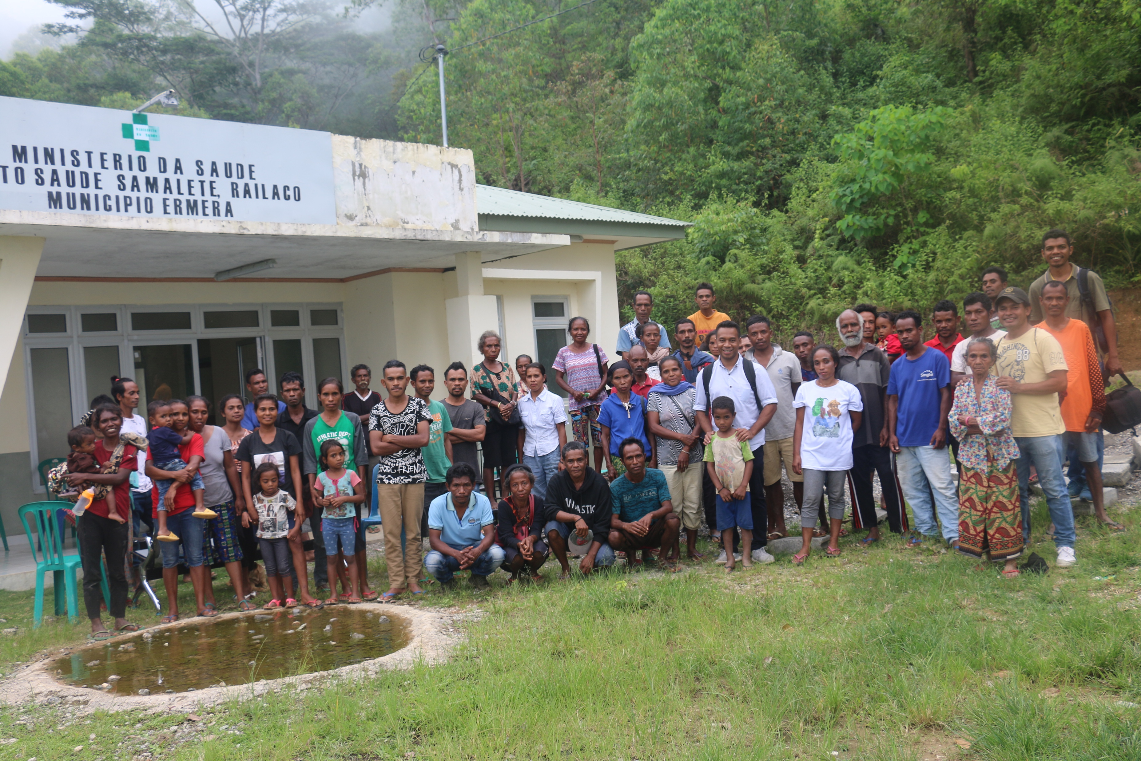
.
Notes:
We enact and fulfil our ministry through the lens of Catholic Social Teaching and Ignatian spirituality, which influences and shapes our relationships, operations and decision-making
We invite companions into authentic and mutually transformative relationships with Jesuit Mission, our international partners and the communities they serve to build awareness of global injustice and inspire actions of solidarity for a more just world.
We strengthen the accompaniment of our international partners to enable poor and marginalised communities to build the skills, capacity and resilience to live full and free lives.
We build a sustainable mission underpinned by a strong financial base, operational excellence, good governance and are supported by passionate people who share our vision, mission and values.

